Slide 1






EMOTION DETECTION AND DEPRESSION SCREENING
Student Details
Name: SAKTHI SUBASH A S
NM Id: AU2021509037
College Name : MADRAS INSTITUTE OF TECHNOLOGY

Slide 2
ABSTRACT
This project aims to develop a data-driven approach for emotion detection and depression screening using machine learning techniques. Emotions play a crucial role in mental health, and detecting signs of depression early can significantly improve outcomes. We employ facial expression recognition and sentiment analysis on textual data to capture emotional states. The project utilizes deep learning algorithms to analyze facial expressions and natural language processing techniques for sentiment analysis. The dataset consists of labeled images and textual data collected from various sources, including social media platforms and clinical databases. Through the integration of these techniques, we aim to build a robust model capable of accurately detecting emotions and screening for depression.

Slide 3

PROBLEM STATEMENT
In today's digital age, mental health concerns, particularly depression, have become increasingly prevalent. Early detection and intervention are crucial for improving outcomes and reducing the burden of depression.
However, traditional screening methods often rely on self-reporting, which can be subjective and prone to bias. This project aims to address these challenges by developing a data-driven approach for emotion detection and depression screening using machine learning techniques.

Slide 4

AIM AND OBJECTIVE
Aim:
The aim of this project is to develop a machine learning-based system for emotion detection and depression screening, aiming to provide an effective tool for early intervention and support in mental health care.
Objective:
Develop a machine learning system for emotion detection and depression screening, integrating facial expression recognition and sentiment analysis models for early intervention in mental health care, while ensuring adherence to ethical guidelines and providing a user-friendly interface for accessibility.

Slide 5

PROPOSED SOLUTION
Develop an AI-based system integrating facial expression analysis, voice tone recognition, text analysis, and physiological signals to objectively assess emotions and detect depression.
The system should be accessible via mobile apps or web platforms, enabling early detection, proactive intervention, and seamless integration with healthcare systems, while ensuring privacy and ethical compliance.

Slide 6
ALGORITHM DEPLOYMENT ORDER
INPUT DATASET
INPUT
IMAGE
RESULT

Slide 7
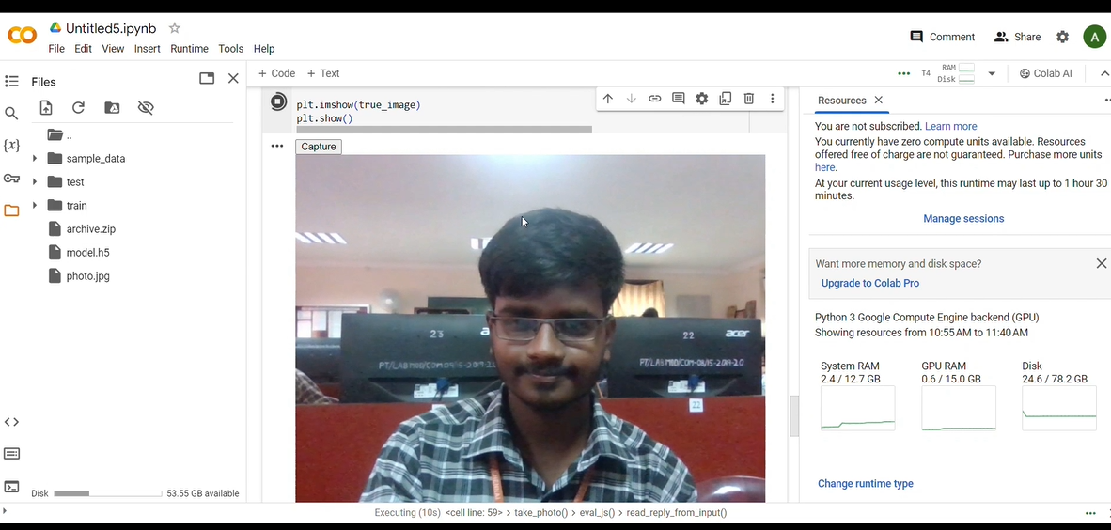
IMAGE CAPTURE

Slide 8
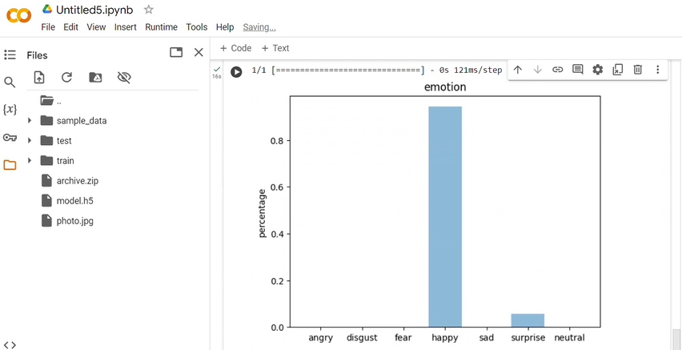
RESULT

Slide 9
FUTURE SCOPE
In the realm of emotion detection and depression screening, the future holds promise for advancements across several key areas.
Leveraging cutting-edge machine learning techniques like deep learning models such as Convolutional Neural Networks (CNNs) and Transformer models can significantly enhance the accuracy and efficiency of emotion detection systems.
Integrating multimodal data analysis, which combines various sources like text, voice, facial expressions, and physiological signals, offers a more holistic understanding of an individual's emotional state and mental health.
Real-time monitoring systems, personalized recommendations, and interventions tailored to individual needs could revolutionize how mental health support is delivered, while ethical considerations and privacy protection remain paramount. Integration with healthcare systems and validation through longitudinal studies are crucial steps toward ensuring the effectiveness and accessibility of these technologies in promoting mental well-being on a broader scale

Slide 10

VIDEO OF THE PROJECT

Slide 11
CONCLUSION
Our projects helps people to identify their current state of their mind and helps them to rectify it.
Our project has also prioritized ethical considerations, underscoring our commitment to responsible technology deployment in mental health contexts.
Looking ahead, ongoing refinement of algorithms, validation studies, integration with healthcare systems, and longitudinal research will further solidify the efficacy and impact of our solution, ultimately fostering proactive mental health support and intervention.

Slide 12
REFERENCES
https://blog.clairvoyantsoft.com/emotion-recognition-with-deep-learning-on-google-colab-24ceb015e5

Slide 13
THANK YOU

